Slide 1
lsgr
'ls' + 'grep' command line utility

Slide 2
what lsgr does:
lsgr is functionally equivalent to piping ls to grep.
for those unfamiliar with unix:
'ls' and 'grep' are command line utilities.
ls returns the contents of the current working directory.
grep returns members of a data structure that meet a regular expression.
'piping' allows users to use the output of one command as input for another.
example: ls | grep [a-b]
ls returns the contents of the current working directory and passes them to grep;
grep checks if any of the items contain a lowercase letter a or b.
if they do, they will be returned.
if they don't, they are ignored.
lsgr searches a directory for items that match a regular expression, sorts the results alphabetically, and then returns them.

Slide 3
how lsgr does this:
uses the standard regex module provided with python
implements merge sort on it's own, otherwise there's no challenge

Slide 4
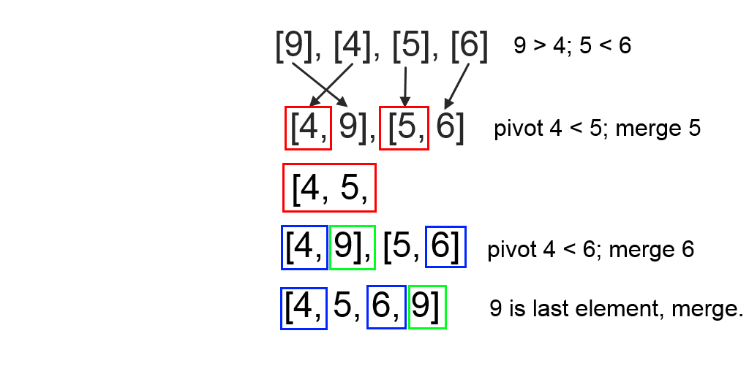
how lsgr does this: merge sort
Merge sort is a divide and conquer sorting algorithm.
it first divides the unsorted list into smallest possible sublists.
[9, 4, 5, 6] → [9, 4], [5, 6] → [9], [4], [5], [6]
then it compares and merges adjacent elements.

Slide 5
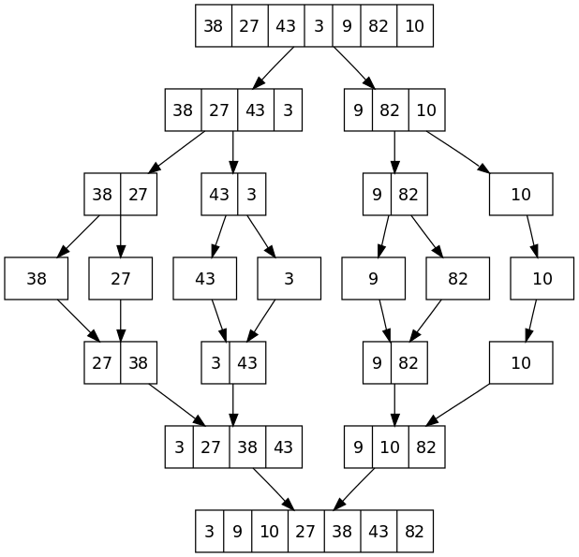
top-down mergesort solution

